Slide 1

Simulation and exploration of Thz TRNASMISSION LINES
Name: Mohammed AlShuaili
ID: 20106181
Supervisor: Dr Marissa Condon

Slide 2



Problem Description
The Challenge: Efficiently model THz transmission lines considering high attenuation, dispersion, and non-linearities.
Why It's Important: Key to enabling technologies like 6G, high-speed communication, and biomedical imaging.

Slide 3

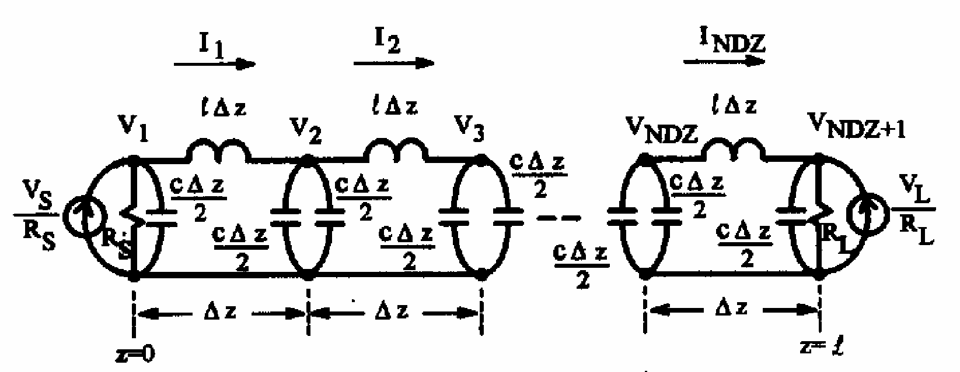
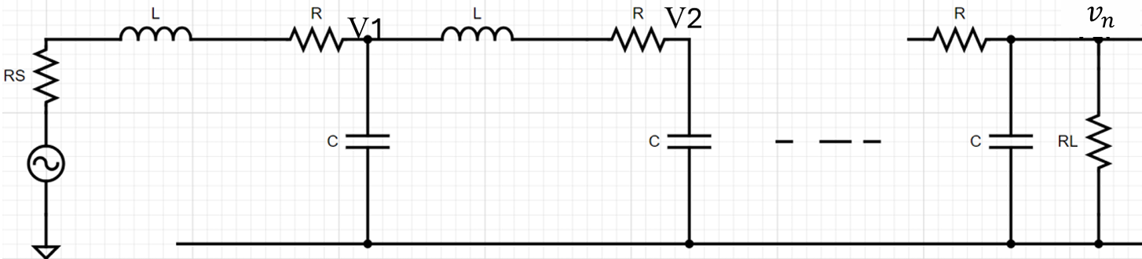
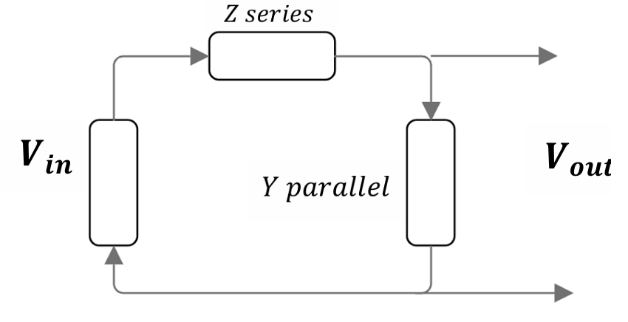


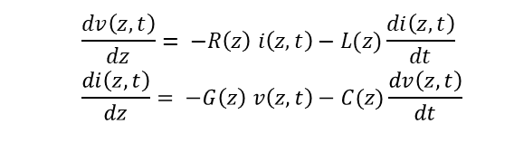
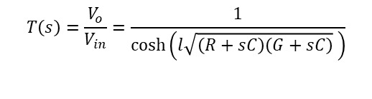

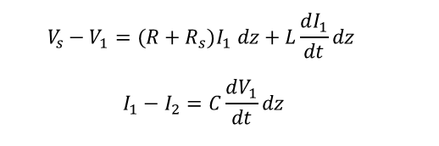
Proposed Solutions
Objective: Develop accurate, efficient numerical model.
FDTD: Initial time-domain approximation.
RLC Ladder Models: Discretization for computational efficiency.
NILT: Numerical transformation for validation and accuracy.
$$\frac{dv\left(z,t\right)}{dz}= −R\left(z\right) i\left(z,t\right)−L(z)\frac{di\left(z,t\right)}{dt}$$
$$\frac{di\left(z,t\right)}{dz}= −G\left(z\right) v\left(z,t\right)−C(z)\frac{dv\left(z,t\right)}{dt}$$
$$v_{k}^{n+1}=v_{k}^{n}−\frac{Δt}{ΔzC}(i_{k}^{n+\frac{1}{2}}−i_{k−1}^{n+\frac{1}{2}})$$
$$i_{k−1}^{n+3/2}=i_{k}^{n+1/2}−\frac{Δt}{Δzl}(v_{k+1}^{n+1}−v_{k}^{n+1})$$
Figure 1: shows FDTD as in [1].
$$V_{s}−V_{1}=(R+R_{s})I_{1} dz+L\frac{dI_{1}}{dt}dz$$
$$I_{1}−I_{2}=C\frac{dV_{1}}{dt}dz$$
$$\frac{dI_{n}}{dt}= −\frac{1}{L}V_{n}−\frac{R_{s}+R}{L}I_{n}+\frac{1}{L}V_{n−1}$$
$$\frac{dV_{n}}{dt}=\frac{1}{C}I_{n}−\frac{1}{C}I_{n+1}$$
Figure 2: RLC Ladder approximation.
$$Y=G+sC, Z=\left(R+sL\right),$$
$$T\left(s\right)=\frac{V_{o}}{V_{in}}=\frac{1}{\cosh\left(l\sqrt{\left(R+sC\right)\left(G+sC\right)} \right)}$$
Figure 3: Exact solution in the s-domain.

Slide 4
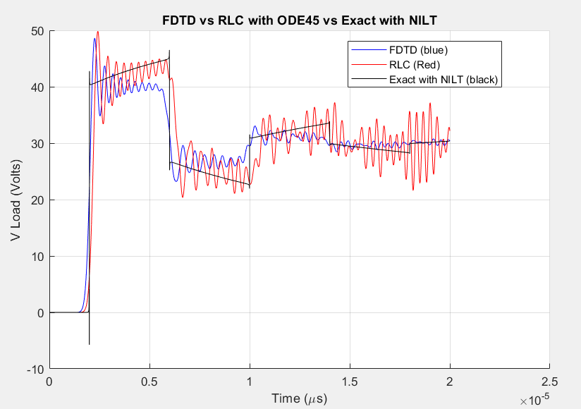
Work Progress
Completed Tasks:
- Implemented FDTD for lossless lines in MATLAB.
- Simulated RLC ladder networks; validated accuracy with different section counts.
- Applied NILT for s-domain solutions.
Results:
- FDTD and RLC ladder methods show promising accuracy.
- Challenges with optimizing section counts for computational efficiency.
Figure 4: FDTD vs RLC vs Exact results.

Slide 5
Key Challenges and Mitigation
Challenges:
Deriving a time-domain model to match s-domain solutions AWE.
Validating the model across wide frequency.
Mitigation:
Integrate AWE into the RLC with varying section counts.
Use iterative testing and error analysis to refine the model.

Slide 6


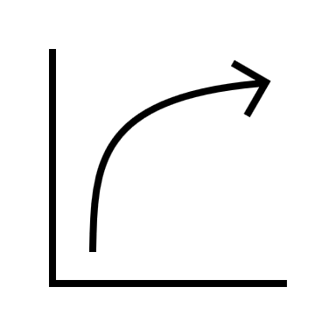






Project Plan for Semester 2
Week 1-3: Validate and refine models using s-domain and time-domain techniques.
1
Week 4-7: Test models at varying THz frequencies and derive equivalent time-domain representation.
2
Week 8-10: Investigate PSPICE simulations; finalize report.
3

Slide 7
Conclusion and Future Plans
Achievements:
- Progress in modeling approaches; validated results demonstrate feasibility.
Next Steps:
- Extend models for complex THz systems; explore real-world applications.

Slide 8
References
1. C. R. Paul, "Incorporation of terminal constraints in the FDTD analysis of transmission lines," in IEEE Transactions on Electromagnetic Compatibility, vol. 36, no. 2, pp. 85-91, May 1994, doi: 10.1109/15.293284.

